Slide 1
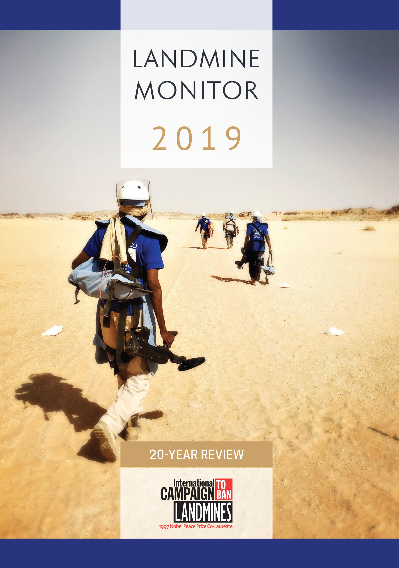

Launch of
Landmine Monitor 2019
20-Year Review
Oslo & Geneva
Thursday, 21 November
10.30 CET

Slide 2
Host
Renata Dwan UNIDIR Director
Ban Policy
Steve Goose Arms Division Director, HRW
Victim Assistance
Loren Persi Editor
Support
Marion Loddo Editor
Mine Action
Morgan McKenna Coordinator

Slide 3
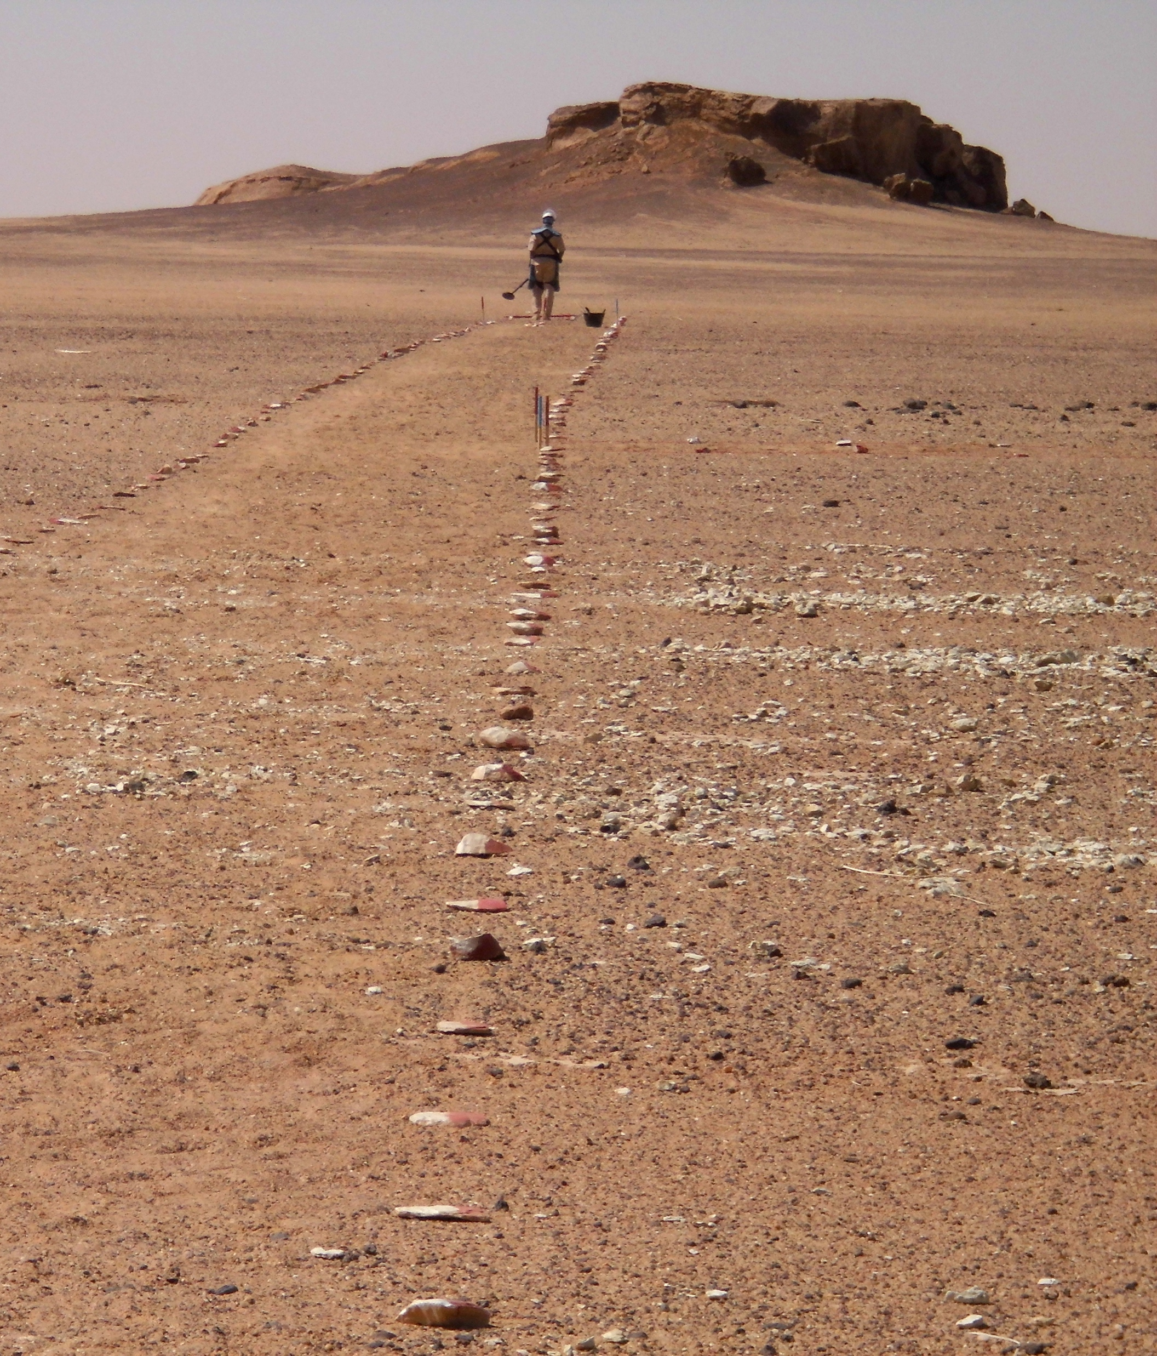


Landmine Monitor 2019
Status & Use
164 States Parties to the Mine Ban Treaty; the Marshall Islands is the last signatory yet to ratify
From mid-2018–October 2019, confirmed new use by the government forces: Myanmar
NSAGs use in at least six countries: Afghanistan, India, Myanmar, Nigeria, Pakistan, and Yemen
As yet unconfirmed allegations of new mine use by NSAGs in Cameroon, Colombia, Mali, Libya, Philippines, Somalia, and Tunisia
A deminer busy at work at a HI demining operation
in Chad. Demining is done by corridors
© Humanity & Inclusion, 2019

Slide 4
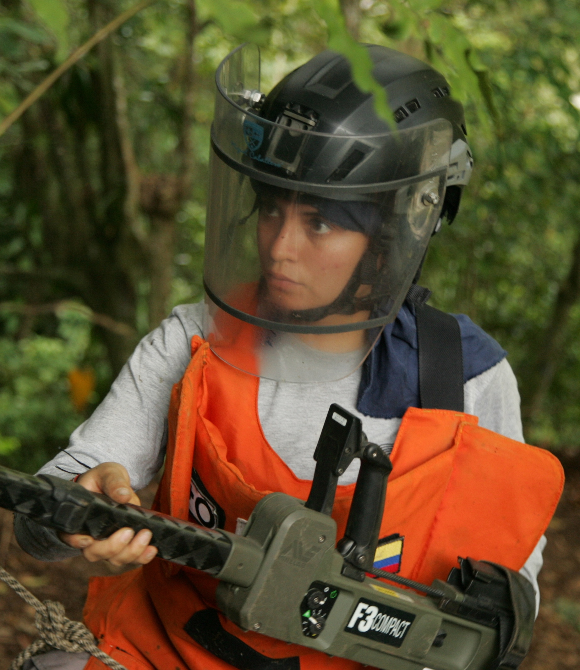
Landmine Monitor 2019
Stockpiles & Production
States Parties have destroyed more than 55 million stockpiled antipersonnel mines, incl. 1.4 million+ in 2018.
In 1999, all states stockpiled about 160 million antipersonnel mines. Today, global total could be less than 50 million.
States most likely to be actively producing during the past year are India, Myanmar, and Pakistan.
NSAGs produced improvised landmines in Afghanistan, Colombia, Myanmar, Nigeria, Pakistan, Tunisia, and Yemen.
A female deminer working on particularly difficult terrain for mine clearance activities in Colombia
© CCCM, 2019

Slide 5
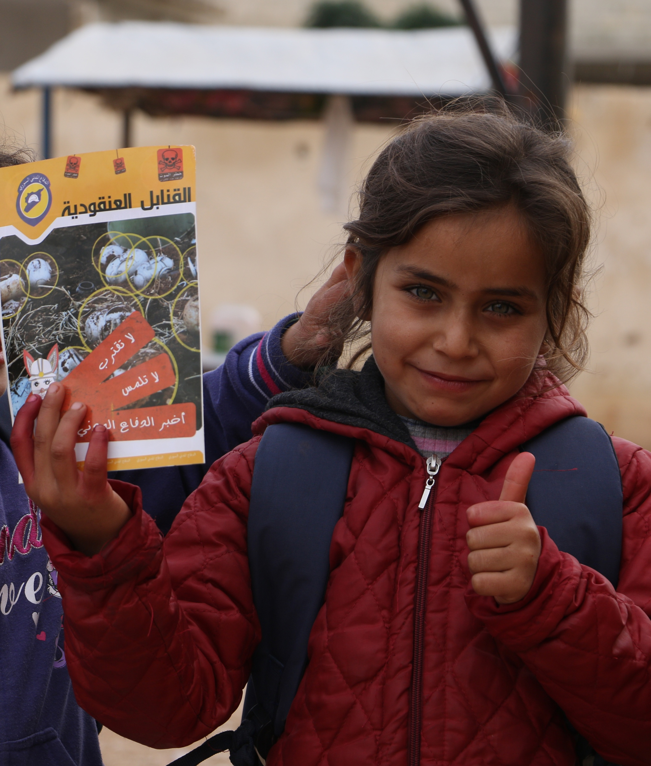
Landmine Monitor 2019
Casualties
Monitor recorded 6,897 people killed or injured by mines/ERW—3,059 killed; 3,837 injured; one casualty unknown.
2018, the fourth year in a row with exceptionally high numbers of recorded casualties.
71% of recorded landmine/ERW casualties were civilians where their status was known.
Children accounted for 54% of all civilian casualties where the age was known; 7% more than 2017, and 12% more than 2016.
A White Helmets team provided risk education to
81 boys and 59 girls at a school in Hama, Syria
© Michael Edwards/Mayday Rescue, November 2018

Slide 6
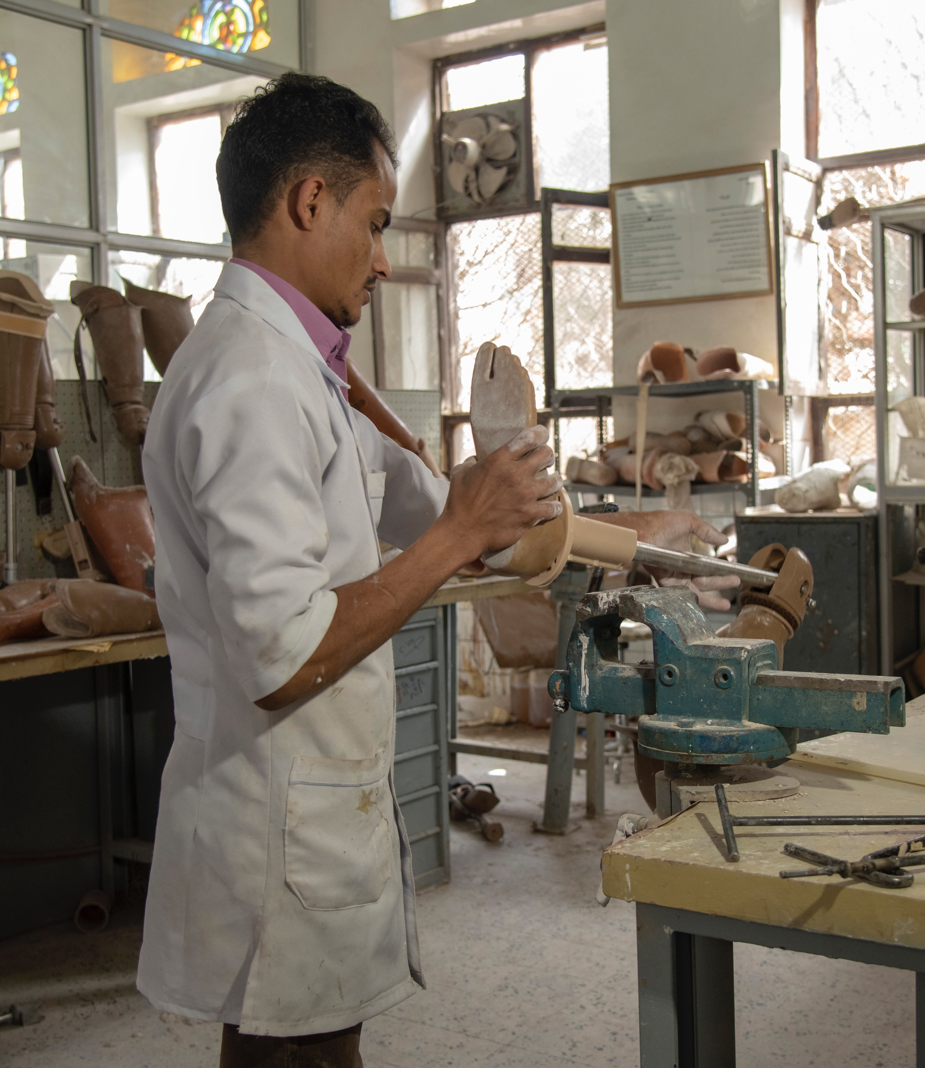
Landmine Monitor 2019
Victim Assistance
Monitor has recorded more than 130,000 mine/ERW casualties since tracking began in 1999, including some 90,000 survivors.
33 States Parties with significant numbers of mine victims.
Following reductions in resources, many countries saw near-stagnation in the remaining core assistance services
Significant gaps in access to employment, training, and other income-generation support activities
HI partner with a prosthetic manufacturing
workshop in Sanaa, Yemen
© ISNA Agency/HI, 2019

Slide 7
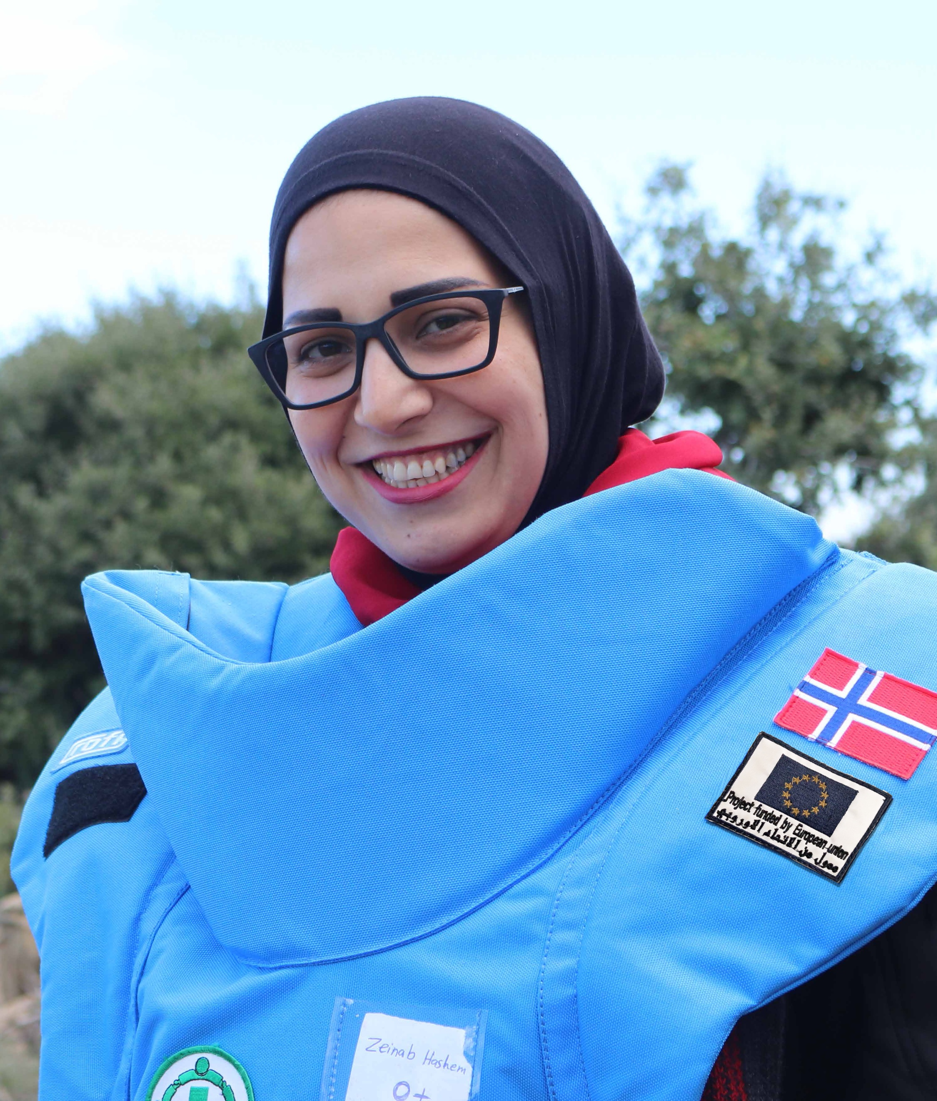
Landmine Monitor 2019
Support for Mine Action
Approx. US$699.5 million in combined support in 2018 – decrease of $95.1 million (12%) on 2017.
$642.6 million by international donors – decrease of $53.7 million (8%) on 2017.
  Top 5 mine action donors—US, EU, UK, Norway, Germany—contributed $458.1 million (71%).
  5 states—Iraq, Afghanistan, Syria, Croatia, Lao PDR—received $351.2 million (55%)
$56.9 million in national support by 8 affected states – decrease of $41.4 million (42%) on 2017.
Deminer Zeinab Hashem in southern Lebanon
© NPA Lebanon, December 2018

Slide 8
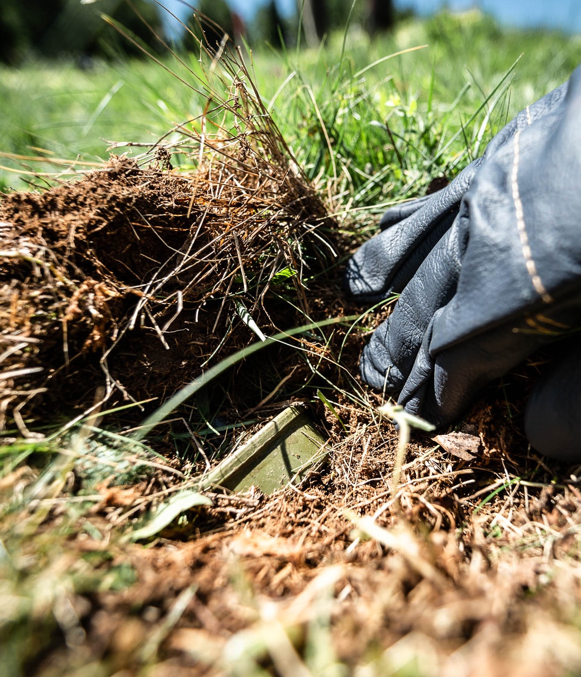
Landmine Monitor 2019
Contamination & Clearance
59 states and areas contaminated mines – 33 States Parties, 22 states not party, 4 areas
At least 140km² reported cleared of in 2018, decrease on 195km² in 2017
2014–2018 total clearance among States Parties estimated at 800km², at least 661,491 landmines destroyed
Afghanistan, Cambodia, Croatia, and Iraq have cleared more than 83%
31 States Parties, 1 state not party, 1 area have completed clearance of all mined areas since 1999
A mine in the ground in Bosnia and Herzegovina
© Johannes Muller/NPA, 2019

Slide 9
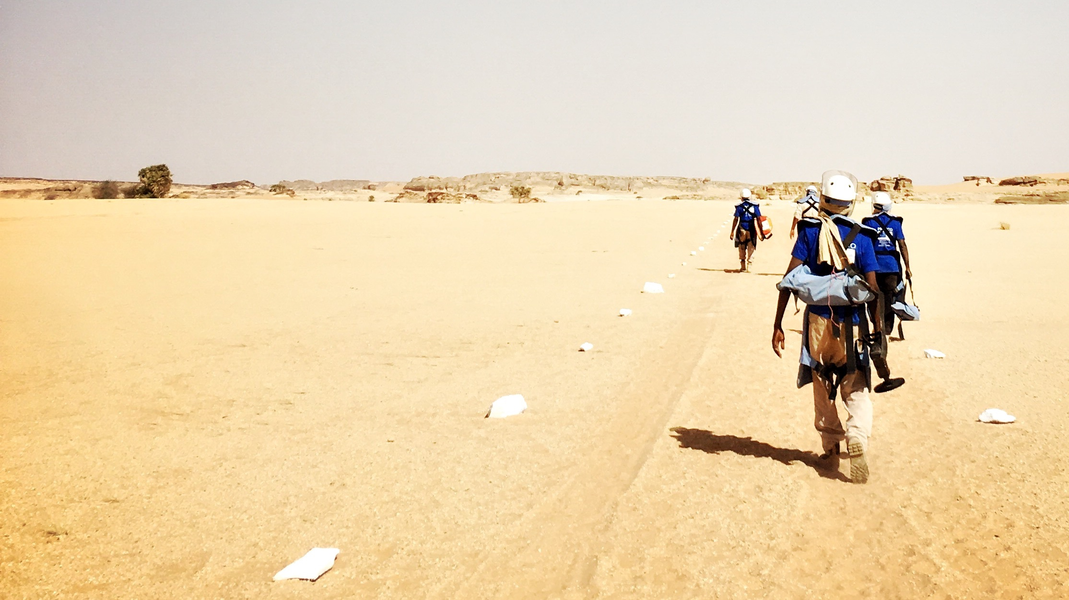
Landmine Monitor 2019
Twenty Years of Reporting
Delegates Briefing & Toast
Mine Ban Treaty Fourth Review Conference
Clarion Hotel The Hub, Oslo
Tuesday, 26 November 2019
17:30–19:00, Room 1
Photo: © Gilles Lordet/HI

Slide 10
Ban Policy
Steve Goose gooses@hrw.org
Victim Assistance
Loren Persi loren@icblcmc.org
Support
Marion Loddo marion@icblcmc.org
Mine Action
Morgan McKenna morgan@icblcmc.org

