Slide 1
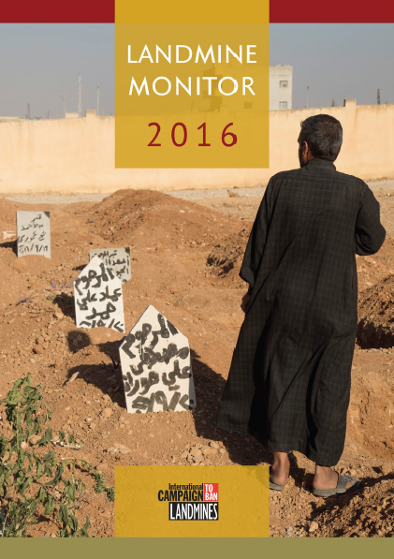

A family member stands next to the graves of three children who were killed when an improvised mine planted by the so-called Islamic State (IS) in a school in Manbij, Syria, detonated on 27 September 2016.
© Ole Solvang/Human Rights Watch, October 2016
Notes:
Breaking from what have been recent past covers of Landmine Monitor annual reports, this year we felt appropriate and are saddened to show the tragedy of landmine use documented in the past year. Pictured here a family member near gravesites of children killed by improvised mines in Syria.

Slide 2
Main Sections of Report
Landmine Ban Policy
Contamination and Clearance
Casualties and Victim Assistance
Support for Mine Action
Notes:
Landmine Monitor 2016, the 18th annual edition, provides a global overview of efforts in 2015, and into October 2016 where possible.
The report is divided into four chapters, while updated country profiles are available online.
This presentation generally follows the order of these sections, highlighting the Major Findings of the report.

Slide 3
Landmine Monitor 2016: overview
Global ban endures; landmines used by very few government forces—all outside the Mine Ban Treaty—and by non-state actors in 10 countries
Casualties rose to decade-high level
Support for mine action at lowest level in ten years
Clearance continues, but only a few countries on track
Notes:
Landmine Monitor 2016 continues to detail progress toward the goal of a mine-free world, but also reports a decade-high number of casualties, at a time when support for mine action fell to its lowest levels in 10 years.
Rejection of antipersonnel mines remains the global norm even as non-state armed groups and a small number of states not party to the Mine Ban Treaty use the weapons.
Many countries continue to clear mine contamination, however global clearance declined in 2015 and very few States Parties appear to be on track to meet clearance deadlines.

Slide 4
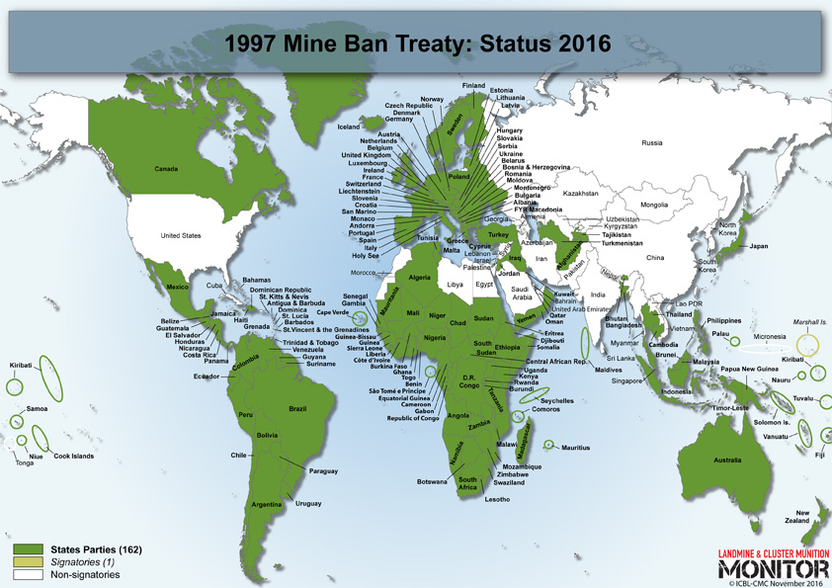
Mine Ban Treaty
There are 162 State Parties to the Treaty, and one signatory.
Marshall Islands has not yet ratified.
Notes:
There were no new ratifications or accessions in the reporting period. The last country to accede was Oman in August 2014.
In March 2016, it was announced that Sri Lanka’s cabinet of ministers had approved accession to the Mine Ban Treaty, but the instrument of accession had not been deposited as of 1 November 2016.

Slide 5
Landmine Use
Use of antipersonnel mines by states remains rare
No confirmed new use of the weapons by States Parties during October 2015 – October 2016
Government forces in states not party Myanmar, North Korea, and Syria used antipersonnel landmines in the past year
Non-state armed groups used antipersonnel landmines in 10 countries
Notes:
The use of antipersonnel mines by states remains a relatively rare phenomenon.
There was no confirmed new use of the weapons by States Parties from October 2015 through October 2016.
The government forces of Myanmar, North Korea, and Syria—all states not party to the Mine Ban Treaty—again used antipersonnel landmines in the past year.
Over the past year, non-state armed groups have used antipersonnel landmines in 10 countries: Afghanistan, Colombia, Iraq, Libya, Myanmar, Nigeria, Pakistan, Syria, Ukraine, and Yemen.
Non-state armed groups mostly used improvised mines, also known as victim-activated improvised explosive devices (IEDs), and booby traps—rather than factory-made landmines. Such devices are banned by the Mine Ban Treaty as they explode due to the presence, proximity, or contact of a person.
The Monitor recorded but could not independently verify allegations of new mine use in States Parties Cameroon, Chad, Niger, Philippines, and Tunisia, or in states not party Iran and Saudi Arabia.

Slide 6
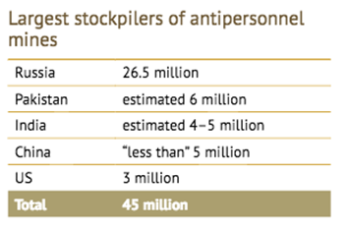
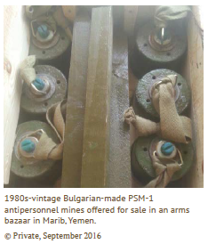
Stockpile Destruction, Production
& Transfer
States Parties destroyed > 2.1 million landmines in 2015
4 States Parties still have stocks to destroy - Ukraine, Belarus, Greece remain beyond their treaty deadlines
31 of 35 non-states parties estimated to stockpile landmines
11 producers include: China, Cuba, India, Iran, Myanmar, North Korea, Pakistan, Russia, Singapore, South Korea, and Vietnam. Most likely to be actively producing are: India, Myanmar, Pakistan & South Korea
Non-state armed groups producing antipersonnel landmines & improvised mines in: Afghanistan, Colombia, Iraq, Myanmar, Nigeria, Pakistan, Somalia & Syria
Low level of illicit transfer appears to continue, de facto global ban on state-to-state transfers continues
Notes:
Collectively, States Parties have destroyed more than 51 million stockpiled antipersonnel mines, including more than 2.1 million destroyed in 2015.
Four States Parties possess more than seven million antipersonnel mines remaining to be destroyed: Ukraine (5.4 million), Belarus (1.5 million), Greece (643,265), and Oman (15,734). Ukraine, Belarus, and Greece all missed their treaty-mandated destruction deadlines.
The Monitor estimates that as many as 31 of the 35 states not party to the Mine Ban Treaty stockpile landmines. In 1999, the Monitor estimated that, collectively, states not party stockpile about 160 million antipersonnel mines, but today the global total may be less than 50 million.
Transfer and Production
The Monitor identifies 11 states as producers of antipersonnel mines, unchanged from the previous report: China, Cuba, India, Iran, Myanmar, North Korea, Pakistan, Russia, Singapore, South Korea, and Vietnam.
Most of these countries are not believed to be actively producing mines but reserve the right to do so. Those most likely to be actively producing are India, Myanmar, Pakistan, and South Korea.
Non-state armed groups in countries including Afghanistan, Colombia, Iraq, Myanmar, Nigeria, Pakistan, Somalia, and Syria make antipersonnel mines, including victim-activated IEDs (improvised mines).
A de facto global ban on the state-to-state transfer of antipersonnel mines has been in effect since the mid-1990s.
Use of factory-produced antipersonnel mines in States Parties Yemen and Ukraine, where declared stockpiles had been destroyed, indicates that some illicit transfers have occurred either internally among actors or from sources external to the country

Slide 7
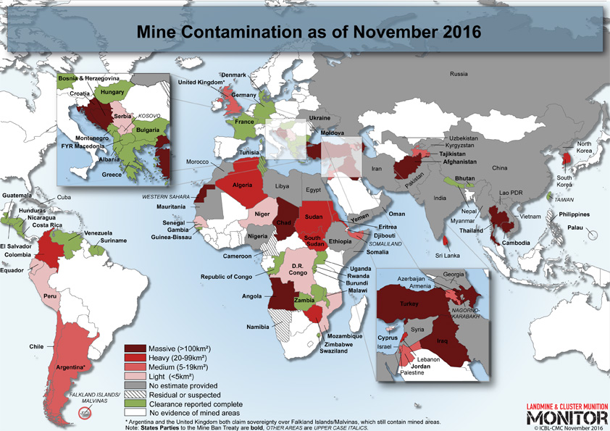
SAMPLE
Notes:
A global picture of landmine contamination

Slide 8
Contamination
64 states and areas contaminated by antipersonnel mines (up from 61 states and areas in 2014)
36 States Parties to Mine Ban Treaty, 24 states not party, 4 other areas
Increase due to: new use of antipersonnel mines in Nigeria, and acquisition of new data on pre-existing contamination in Palau and Mozambique
Massive contamination (>100 km² per country) believed to exist in Afghanistan, Angola, Azerbaijan, Bosnia and Herzegovina, Cambodia, Chad, Croatia, Iraq, Thailand, Turkey and in area of Western Sahara
Notes:
Sixty-four states and areas are contaminated by antipersonnel mines as of October 2016.
This includes 36 States Parties to the Mine Ban Treaty, 24 states not party, and four other areas. This is an increase from 61 states and areas in 2015.
The increase is due to new use of antipersonnel mines, including improvised mines, in Nigeria, and to the acquisition of new data on pre-existing contamination in Palau and Mozambique.
Massive antipersonnel mine contamination (more than 100 km² total per country) is believed to exist in Afghanistan, Angola, Azerbaijan, Bosnia and Herzegovina, Cambodia, Chad, Croatia, Iraq, Thailand, Turkey, and in the area of Western Sahara.

Slide 9
Clearance
About 171 km² reported to be cleared of landmines in 2015
In 2015 nearly 158,000 antipersonnel mines and some 14,000 antivehicle mines were destroyed
Clearance lower than in 2014, due to factors including decrease in funding
70% of 2015 clearance took place in Afghanistan, Cambodia, Croatia
Ukraine is in violation of article 5 of the Mine Ban Treaty having missed its 1 June 2016 clearance deadline
Only 4 State parties on track to meet their clearance deadlines: Algeria, Chile, Democratic Republic of Congo, and Ecuador
Notes:
About 171 km² of land was reported to be cleared of landmines in 2015, a decrease from an estimated 201 km² in 2014.
In 2015, nearly 158,000 antipersonnel mines and some 14,000 antivehicle mines were destroyed in the context of mine clearance.
As in 2014, the largest total clearance of mined areas in 2015 was achieved in Afghanistan, Cambodia, and Croatia, which together accounted for more than 70% of recorded clearance.
It is not possible to attribute the 2015 decrease in clearance to a single cause, but the severe reduction in funding available for mine action probably played a major role.
Over the past five years, approximately 960 km² of mined areas have been cleared. Some 1.3 million antipersonnel and more than 66,000 antivehicle mines have been destroyed in the context of mine clearance.
Twenty-six States Parties, one state not party, and one other area have completed clearance of all mined areas on their territory since the Mine Ban Treaty entered into force in 1999.
One state, Ukraine, is in violation of Article 5 of the Mine Ban Treaty due to missing its 1 June 2016 clearance deadline without being granted an extension.
Five States Parties were granted extended clearance deadlines at the Fourteenth Meeting of States Parties in 2015: Cyprus, Ethiopia, Mauritania, Niger, and Senegal. Two States Parties requested deadline extensions in 2016, awaiting approval at the Fifteenth Meeting of States Parties: Niger and Peru.
Only four States Parties appear to be on track to meet their treaty-mandated clearance deadlines: Algeria, Chile, Democratic Republic of the Congo, and Ecuador.

Slide 10
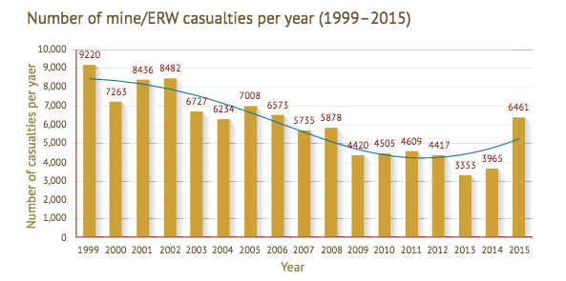
Casualties
In 2015 the Monitor recorded 6,461 mine/ERW casualties, a 75% increase compared to 2014 (3,965)
The increases are due to more recorded casualties in armed conflict in Libya, Syria, Ukraine and Yemen
2015 saw highest number of casualties from improvised mines
Notes:
In 2015, there was a sharp rise in the number of people killed and injured by mines, victim-activated IEDs that mostly act as antipersonnel mines (also called improvised mines), cluster munition remnants, and other explosive remnants of war (ERW).
In 2015, the Monitor recorded 6,461 mine/ERW casualties, of which at least 1,672 people were killed, marking a 75% increase from casualties recorded for 2014. A revised total of 3,695 casualties was recorded in 2014.
The sharp increase in casualties in 2015 was due to more casualties recorded in armed conflicts in Libya, Syria, Ukraine, and Yemen. The increase also reflects greater availability of casualty data, particularly from unique systematic surveys of persons injured in Libya and Syria in 2015.
The casualty total in 2015 marked the most annual recorded casualties since 2006.
2015 also marked the highest number of annual casualties by improvised mines (also known as IEDs) recorded by the Monitor, with 1351 recorded in 2015 (compared to 1,075 in 2014)

Slide 11
Casualties in more detail
Casualties in 56 states and 5 other areas in 2015
37 of which are States Parties to the Mine Ban Treaty
78% of casualties were civilians
Children accounted for 38% of all civilian casualties
Women and girls made up 14% of casualties
60% of recorded casualties occurred in States Parties
Notes:
Casualties were identified in 56 states and five other areas in 2015, of which 37 are States Parties to the Mine Ban Treaty.
The vast majority of recorded landmine/ERW casualties were civilians (78%) where their status was known, which is similar to the past two years.
In 2015, children accounted for 38% of all civilian casualties where the age was known.
Women and girls made up 14% of all casualties where the sex was known, a slight increase compared to recent years.
Some 60% of recorded global casualties occurred in States Parties, down from 70% in 2014.
The Monitor has recorded more than 100,000 mine/ERW casualties for the period since its global tracking in began in 1999, including some 73,000 new survivors.

Slide 12
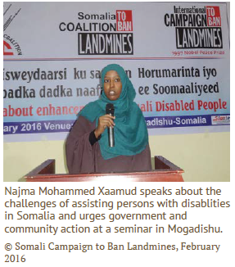
Victim Assistance
Local surveys are important for improved understanding of needs of mine victims continued in States Parties
2/3 of State Parties actively coordinated to advance efforts of mine victims
Victim assistance plans expired in: Burundi, Croatia, Senegal, and Uganda without being revised or renewed in 2015. In Afghanistan and Sudan, expired plans for assistance have not been updated since 2011
Assistance efforts often integrated with other disability rights & development efforts
Notes:
Most States Parties to the Mine Ban Treaty with significant numbers of mine victims suffered from a lack of adequate resources to fulfill the commitments of the 2014–2019 Maputo Action Plan. Findings below relate to the 31 States Parties with significant numbers of mine victims.
Localized surveys to improve understanding of the needs of mine victims continued in in most States Parties.
Approximately two-thirds of the States Parties had active coordination mechanisms or relevant national plans in place to advance efforts to assist mine victims and uphold their rights. However, victim assistance plans expired in Burundi, Croatia, Senegal, and Uganda without having been revised or renewed in 2015, while expired action plans for assistance in Afghanistan and Sudan have not yet been updated since 2011.
In most States Parties, assistance efforts have been integrated into other disability rights and development efforts, through collaborative coordination, combined planning, and survivor participation. Unfortunately, such integration has not resulted in mobilizing the funding and resources required to fill the growing gap between assistance available and the obligations that states have to victims.
In nearly all the States Parties, survivors were joining in coordination processes that affect their lives, although in many countries their participation must be better supported, especially in decision-making roles. Many States Parties still need to demonstrate that they are doing their utmost to increase survivors’ participation in all relevant matters.
More than half of the States Parties included some information on victim assistance activities and progress in their transparency reports covering calendar year 2015. However, the States Parties still needed to start reporting concretely on time-bound and measurable objectives and progress toward victim assistance goals.

Slide 13
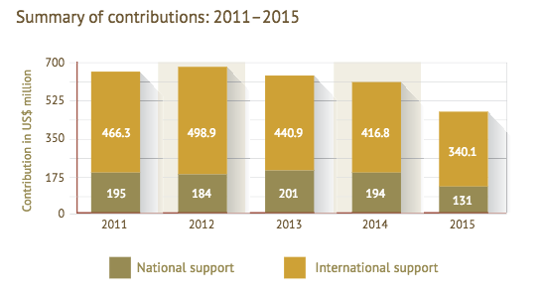
Support for Mine Action: overview
National and international donor support totaled US$471.3 million, a 23% decrease from 2014
Contributions per sector: 64% clearance and risk education, 27% various, 7% victim assistance, 1% Capacity building, 0.5% Advocacy, 0.5% Stockpile destruction
Notes:
Donors and affected states contributed approximately US$471.3 million in international and national support for mine action in 2015,
This was a decrease of $139 million (23%) from 2014, the third year in a row of declining support, and lowest level since 2005.
Contributions per sector: 64% Clearance and risk education, 27% Various, 7% Victim assistance, 1% Capacity building, 0.5% Advocacy, 0,5% Stockpile destruction

Slide 14
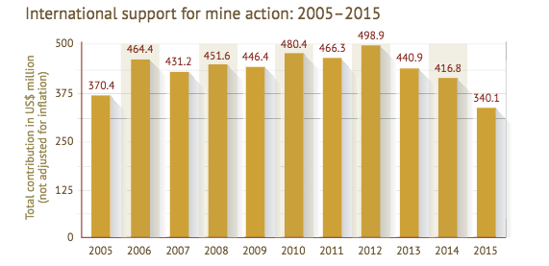
Support for Mine Action: a closer look at donors & recipients
35 international donors contributed $340.1 million to 41 states and 3 other areas, a decrease of $77million
14 affected states provided $131.2 million in contributions to their own national mine action programs, a 32% decrease from last year
Top 5 donors: the US, Japan, the EU, Norway & the Netherlands, contributing 71% ($240 million) of all international funding
Top 5 recipients were Afghanistan, Iraq, Lao PDR, Cambodia and Syria, received 48% ($161.9 million) support
Notes:
Thirty-five donors contributed $340.1 million in international support for mine action to 41 states and three other areas. This represents a decrease of almost $77 million from 2014, and the first time since 2005 that international support fell below $400 million.
The top five mine action donors—the United States, Japan, the European Union, Norway, and the Netherlands—contributed 71% of all international funding, with a combined total of $240 million.
Thirteen donors decreased their funding in 2015, with the EU and Norway accounting for $57 million (74%) of the global decline.
The top five recipient states—Afghanistan, Iraq, Lao PDR, Cambodia, and Syria—received $161.9 million, or 48% of all international support in 2015.
Afghanistan received more funding than any other country for the thirteenth consecutive year.
In 2016, donors hosted three international pledging conferences, during which they committed resources to support mine action activities as well as the treaty’s implementation support unit. While this was an unprecedented number of events of this kind, it is not yet possible to determine how these conferences will impact overall support for mine action in 2016 and future years.
Fourteen affected states reported providing $131.2 million in national support for their own mine action programs, a decrease of $62 million compared with 2014.
National contributions:
The Monitor identified 14 affected states that provided
$131.2 million in contributions to their own national mine action programs, $62.4
million less than in 2014 (a 32% decrease), when 13 affected countries reported
contributing $193.6 million

Slide 15

Additional Resources…
Country profiles
Factsheets & Reports
Maps
Visit www.the-monitor.org
Email monitor2@icblmc.org
Tweet @MineMonitor @minefreeworld
Notes:
Landmine and Cluster Munition Monitor produces several research products including the annual Landmine Monitor and Cluster Munition Monitor reports, online country profile reports, as well as factsheets and special reports, including this year:
“Extraordinary Pledges to Support Mine Action in 2016”
Revised “Impact of Mines/ERW on Children”
The ICBL and CMC websites are excellent resources for additional information and campaign activities. http://www.icbl.org/ and http://www.stopclustermunitions.org/
We extend our gratitude to Monitor contributors*.
Government of Australia
Government of Denmark
Government of France
Government of Germany
Government of Norway
Government of Sweden
Government of Switzerland
Holy See
UNICEF
UN Mine Action Service (UNMAS)
The Monitor’s supporters are in no way responsible for, and do not necessarily endorse, the material contained in this report. We also thank the donors who have contributed to the organizational members of the Monitoring and Research Committee and other participating organizations.
* List accurate as of November 2016.
Thank you!

